Slide 1
Real-time Decentralized Traffic Detection
Richard Zhan

Slide 2
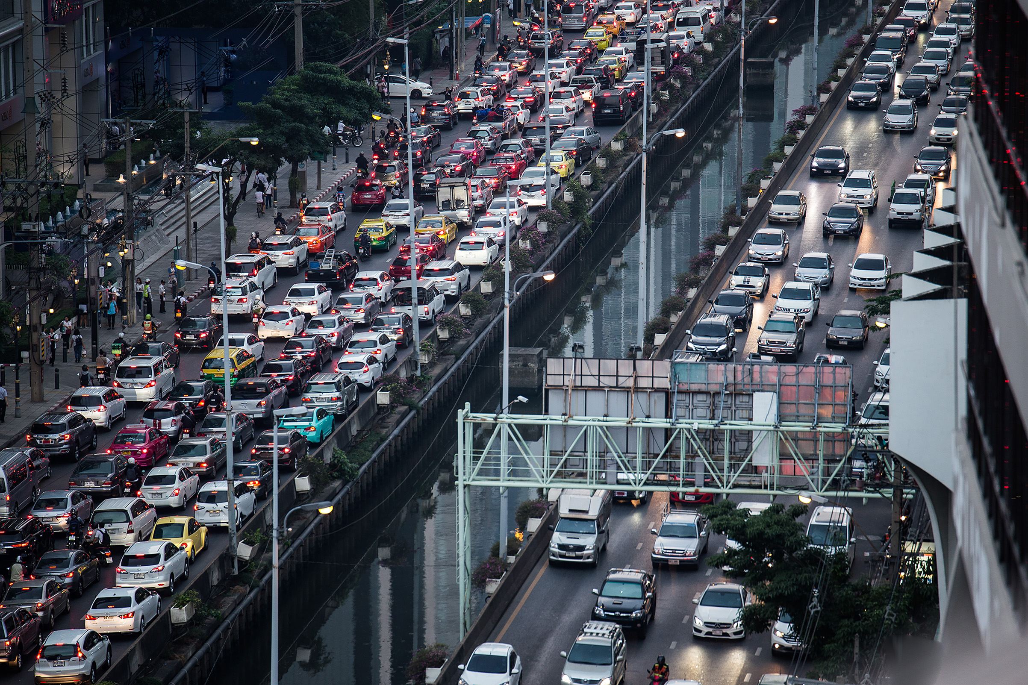
Traffic
Notes:
https://timedotcom.files.wordpress.com/2018/12/GettyImages-1057484678.jpg

Slide 3
Motivations
Global Positioning System

Slide 4
Motivations
Global Positioning System
Previous traffic detection solutions
Large scale monitoring systems

Slide 5
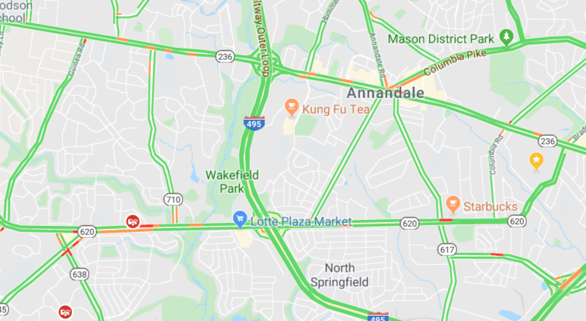
Motivations
Global Positioning System
Previous traffic detection solutions
Large scale monitoring systems
User data - Google Maps

Slide 6
Motivations
Global Positioning System
Previous traffic detection solutions
Large scale monitoring systems
User data - Google Maps
Decentralized traffic detection

Slide 7
Research Proposal
I will simulate a road network and test the effectiveness of decentralized traffic detection (DTD) through car-to-car communication of local slowdowns. I will also determine the minimum density of DTD users necessary for effective decentralized traffic detection.

